Slide 1
Seminar 2
1. Multiplication and Division instructions for unsigned representation
2. Signed conversions
3. Multiplication and Division instructions for signed representation

Slide 2
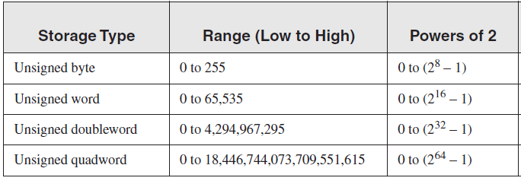
Multiplication and Division instructions for unsigned representation
Unsigned representation – contains natural numbers
Notes:
How does the CPU know whether an arithmetic operation is signed or unsigned?
It doesn’t! The CPU sets all status flags after an arithmetic operation using a set of boolean rules, regardless of which flags are relevant.
the programmer decideS which flags to interpret and which to ignore, based on your knowledge of the type of operation performed.

Slide 3
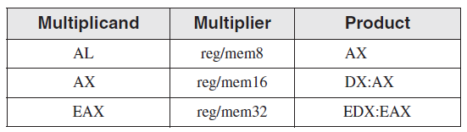
Multiplication Instruction (for unsigned representation)
Syntax: MUL op
op is called explicit operand
The MUL is realized different accordind to the explicit operand:
op is reg/mem8 => MUL reg/mem8 => AL * reg/mem8 = AX
op is reg/mem16 => MUL reg/mem16 => AX * reg/mem16 = DX:AX
op is reg/mem32 => MUL reg/mem32 => EAX * reg/mem32 = EDX:EAX
Notes:
The single operand in the MUL instruction is the multiplier. Table 7-2 shows the default multiplicand and product, depending on the size of the multiplier. Because the destination operand is twice the size of the multiplicand and multiplier, overflow cannot occur.
MUL sets the Carry and Overflow flags if the upper half of the product is not equal to zero.
The Carry flag is ordinarily used for unsigned arithmetic, so we’ll focus on it here.
When AX is multiplied by a 16-bit operand, for example, the product is stored in the combined DX and AX registers.
That is, the high 16 bits of the product are stored in DX, and the low 16 bits are stored in AX.
The Carry flag is set if DX is not equal to zero, which lets us know that the product will not fit into the lower half of
the implied destination operand.
A good reason for checking the Carry flag after executing MUL is to know whether the upper half of the
product can safely be ignored.

Slide 4
Examples: op is reg/mem8 => MUL reg/mem8 => AL * reg/mem8 = AX
Eg 1: 3*4
mov al, 3
mov bl, 4
mul bl ;al*bl = ax
Eg 2: c*4, c byte
mov al, 4
mul byte [c] ;al*[c]=ax
or
mov al, [c]
mov bl, 4
mul bl; al*bl=ax
Eg. 3 a*b, a, b bytes
mov al, [a]
mul byte[b] ; al*[b] = ax
or
mov al, [a]
mov bl, [b]
mul bl ; al*bl = ax

Slide 5
Examples: op is reg/mem16 => MUL reg/mem16 => AX * reg/mem16 = DX:AX
Eg 1: 3*5
mov ax, 3
mov bx, 5
mul bx ;ax*bx = dx:ax
Eg 2: c*4, c word
mov ax, 4
mul word [c] ;ax*[c]=dx:ax
or
mov ax, [c]
mov bx, 4
mul bx; ax*bx=dx:ax
Eg. 3: m*n, m, n word
mov ax, [m]
mul word[n] ; [m]*[n]=dx:ax
Eg. 4: p*r, p-byte, r-word
mov ax,0
mov al, [p]
mul word[r] ; [p]*[r]=dx:ax

Slide 6
Examples: op is reg/mem32 => MUL reg/mem32 => EAX * reg/mem32 = EDX:EAX
Eg. 1: e*f, e, f doubleword
mov eax, [e]
mul dword[f] ; edx:eax=e*f
Eg. 2: g*h, g-byte, h-doubleword
mov eax, 0
mov al, [g]
mul dword[h] ;edx:eax=rez g*h
Eg. 3: 2*f, e, f doubleword
mov eax, 2
mul dword[f] ; edx:eax=2*f
Eg. 4: i*j, i-word, j-doubleword
mov eax, 0
mov ax, [i]
mul dword[j] ;edx:eax=i*j

Slide 7
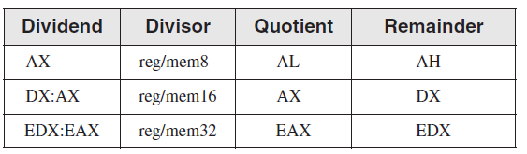
Division Instruction (for unsigned representation)
Syntax: DIV op
op is called explicit operand
The DIV is realized different according to the explicit operand:
op is reg/mem8 => DIV reg/mem8 => AX / reg/mem8 = AL – quotient
and AH – remainder
op is reg/mem16 => DIV reg/mem16 => DX:AX / reg/mem16 = AX – quotient
and DX – remainder
op is reg/mem32 => DIV reg/mem32 => EDX:EAX / reg/mem32 = EAX – quotient
and EDX – remainder

Slide 8
Examples: op is reg/mem8 => DIV reg/mem8 => AX / reg/mem8 = AL – quotient and AH – remainder
Eg. 1: m/n = > word/byte
m dw 31
n db 10
mov ax, [m] ; ax = [m]
Div byte[n] ;ax/[n] = al-cat, ;ah –rest
Eg. 2: 5/r => constant/byte
mov ax, 5
div byte[r] ;ax/[r] = al-cat, ah-rest
Eg. 3: a/b => byte/byte
a db 20
b db 6
mov al, [a]
mov ah, 0 ;ax = [a]
mov bl, [b]
div bl ; ax / bl = a/b = al cat, ; ah-rest

Slide 9
Examples: op is reg/mem16 => DIV reg/mem16 => DX:AX / reg/mem16 = AX – quotient and DX – remainder
Eg. 1: m/n = > word/word
m dw 31
n dw 10
mov ax, [m] ; ax = [m]
mov dx, 0 ;dx:ax = [m]
Div word[n] ;dx:ax/[n] = ax-cat, ;dx, rest
Eg. 2: 5/r => constant/word
mov ax, 5
mov dx, 0
div word[r] ;dx:ax/[r] = ax-cat, ;dx- rest
Eg. 3: a/b => byte/word
a db 20
b dw 6
mov al, [a]
mov ah, 0 ;ax = [a]
mov DX, 0 ;dx:ax = [a]
mov bx, [b]
div bx ; dx:ax / bx = a/b = ax cat, ; dx rest

Slide 10
Examples: op is reg/mem32 => DIV reg/mem32 => EDX:EAX / reg/mem32 = EAX – quotient and EDX – remainder
Eg. 1: m/n = > word/doubleword
m dw 32
n dd 11
mov eax, 0 ; eax=0
mov ax, [m] ; eax = [m]
mov edx, 0 ;edx:eax = [m]
div dword[n] ;edx:eax/[n] = eax-cat, ;edx, rest
Eg. 2: 5/r => constant/doubleword
r dd 3
mov eax, 5
mov edx, 0
div dword[r] ;edx:eax/[r] = eax-cat, edx- rest
Eg. 3: a/b => byte/doubleword
a db 16
b dd 3
mov eax, 0
mov al, [a] ; eax=[a]
mov edx, 0
div dword[b] ;eax – cat, edx avem rest
Eg. 4 c/d =>word/doubleword
c dw 41
d dd 10
mov eax, 0
mov ax, [c] ; eax = [c]
mov edx, 0
div dword[d] ;eax – cat, edx, avem rest

Slide 11
Ex 1 in unsigned representation
A/B – C*2 + D
A BYTE
B WORD
C WORD
D - DOUBLEWORD

Slide 12
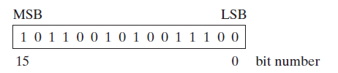
Signed conversions
Extension from a smaller data type to a larger data type based on a sign bit
In sign representation, the most significat bit is sign bit
Bit sign

Slide 13
CBW
The instruction does not have any explicitly specified operands because it is always converting AL → AX
Converts the byte AL to the word AX in the signed interpretation
The conversion refers to the extension of the representation from 8 bits to 16 bits, by filling AH with the sign bit of AL
Eg1:
mov AL, 01110111b
cbw ; AX ← 00000000 01110111b
Eg2:
mov AL, 11110111b
cbw ; AX ← 11111111 11110111b

Slide 14
CWD
The instruction does not have any explicitly specified operands because it is always converting AX → DX:AX
Converts the word AX to the doubleword DX:AX in the signed interpretation
The conversion refers to the extension of the representation from 16 bits to 32 bits, by filling DX with the sign bit of AX
Eg1.
mov ax, 00110011 11001100b
cwd ; DX:AX ← 00000000 00000000 00110011 11001100b
Eg2.
mov ax, 10110011 11001100b
cwd ; DX:AX ← 11111111 11111111 10110011 11001100b

Slide 15
CWDE
The instruction does not have any explicitly specified operands because it is always converting AX → EAX
Converts the word AX to the doubleword EAX in the signed interpretation
The conversion refers to the extension of the representation from 16 bits to 32 bits, by filling the high word of EAX with the sign bit of AX
Eg1:
mov ax, 00110011 11001100b
cwde ; EAX ← 00000000 00000000 00110011 11001100b
Eg2:
mov ax, 10110011 11001100b
cwde ; EAX ← 11111111 11111111 10110011 11001100b

Slide 16
CDQ
The instruction does not have any explicitly specified operands because it is always converting EAX → EDX:EAX
Converts the doubleword EAX to the qword EDX:EAX in the signed interpretation
The conversion refers to the extension of the representation from 32 bits to 64 bits, by filling EDX (the high doubleword) with the sign bit of EAX.
Eg1:
mov eax, 00110011 11001100 00110011 11001100b
cdq ; EDX:EAX ← 00000000 00000000 00000000 00000000 00110011 11001100 00110011 11001100b
Eg2:
mov eax, 10110011 11001100 10110011 11001100b
cdq ;EDX:EAX ← 11111111 11111111 11111111 11111111 10110011 11001100 10110011 11001100b

Slide 17
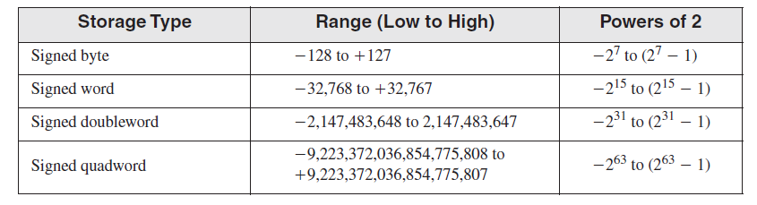
Multiplication and Division instructions for signed representation
signed representation
contains both positive and negative numbers
Notes:
How does the CPU know whether an arithmetic operation is signed or unsigned?
It doesn’t! The CPU sets all status flags after an arithmetic operation using a set of boolean rules, regardless of which flags are relevant.
the programmer decideS which flags to interpret and which to ignore, based on your knowledge of the type of operation performed.

Slide 18
Multiplication Instruction (for signed representation)
Syntax: IMUL op
op is called explicit operand
The MUL is realized different accordind to the explicit operand:
op is reg/mem8 => IMUL reg/mem8 => AL * reg/mem8 = AX
op is reg/mem16 => IMUL reg/mem16 => AX * reg/mem16 = DX:AX
op is reg/mem32 => IMUL reg/mem32 => EAX * reg/mem32 = EDX:EAX
Notes:
The single operand in the MUL instruction is the multiplier. Table 7-2 shows the default multiplicand and product, depending on the size of the multiplier. Because the destination operand is twice the size of the multiplicand and multiplier, overflow cannot occur.
MUL sets the Carry and Overflow flags if the upper half of the product is not equal to zero.
The Carry flag is ordinarily used for unsigned arithmetic, so we’ll focus on it here.
When AX is multiplied by a 16-bit operand, for example, the product is stored in the combined DX and AX registers.
That is, the high 16 bits of the product are stored in DX, and the low 16 bits are stored in AX.
The Carry flag is set if DX is not equal to zero, which lets us know that the product will not fit into the lower half of
the implied destination operand.
A good reason for checking the Carry flag after executing MUL is to know whether the upper half of the
product can safely be ignored.

Slide 19
Examples: op is reg/mem8 => IMUL reg/mem8 => AL * reg/mem8 = AX
Eg 1: -3*4
mov al, -3
mov bl, 4
imul bl ;al*bl = ax
Eg 2: c*(-4), c byte
mov al, -4
imul byte [c] ;al*[c]=ax
or
mov al, [c]
mov bl, -4
imul bl; al*bl=ax
Eg. 3 a*b, a, b bytes
a db -2
b db -5
mov al, [a]
imul byte[b] ; al*[b] = ax
or
mov al, [a]
mov bl, [b]
imul bl ; al*bl = ax

Slide 20
Examples: op is reg/mem16 => IMUL reg/mem16 => AX * reg/mem16 = DX:AX
Eg 1: -3*(-5)
mov ax, -3
mov bx, -5
imul bx ;ax*bx = dx:ax
Eg 2: c*(-4), c word
mov ax, -4
imul word [c] ;ax*[c]=dx:ax
or
mov ax, [c]
mov bx, -4
imul bx; ax*bx=dx:ax
Eg. 3: m*n, m, n word
m dw -6
n dw 7
mov ax, [m]
imul word[n] ; [m]*[n]=ax:ax
Eg. 4: p*r, p-byte, r-word
mov al, [p]
CBW ;ax = [p]
imul word[r] ; [p]*[r]=dx:ax

Slide 21
Examples: op is reg/mem32 => IMUL reg/mem32 => EAX * reg/mem32 = EDX:EAX
Eg. 1: e*f, e, f doubleword
mov eax, [e]
imul dword[f] ; edx:eax=e*f
Eg. 2: g*h, g-byte, h-doubleword
mov al, [g]
CBW ; AX= [g]
CWDE ; EAX= [g]
imul dword[h] ;edx:eax=rez g*h
Eg. 3: 2*f, e, f doubleword
mov eax, 2
imul dword[f] ; edx:eax=2*f
Eg. 4: i*j, i-word, j-doubleword
mov ax, [i] ;AX=[i]
CWDE ;EAX=[i]
imul dword[j] ;edx:eax=i*j

Slide 22
Division Instruction (for signed representation)
Syntax: IDIV op
op is called explicit operand
The DIV is realized different according to the explicit operand:
op is reg/mem8 => IDIV reg/mem8 => AX / reg/mem8 = AL – quotient
and AH – remainder
op is reg/mem16 => IDIV reg/mem16 => DX:AX / reg/mem16 = AX – quotient
and DX – remainder
op is reg/mem32 => IDIV reg/mem32 => EDX:EAX / reg/mem32 = EAX – quotient
and EDX – remainder

Slide 23
Examples: op is reg/mem8 => IDIV reg/mem8 => AX / reg/mem8 = AL – quotient and AH – remainder
Eg. 1: m/n = > word/byte
m dw -31
n db 10
mov ax, [m] ; ax = [m]
idiv byte[n] ;ax/[n] = al-cat, ;ah –rest
Eg. 2: -5/r => constant/byte
r db 2
mov ax, -5
idiv byte[r] ;ax/[r] = al-cat, ah-rest
Eg. 3: a/b => byte/byte
a db -20
b db 6
mov al, [a]
cbw ;ax = [a]
mov bl, [b]
idiv bl ; ax / bl = a/b = al cat, ; ah-rest
;sau idiv byte[b]

Slide 24
Examples: op is reg/mem16 => IDIV reg/mem16 => DX:AX / reg/mem16 = AX – quotient and DX – remainder
Eg. 1: m/n = > word/word
m dw 31
n dw -10
mov ax, [m] ; ax = [m]
CWD ;dx:ax = [m]
idiv word[n] ;dx:ax/[n] = ax-cat, ;dx, rest
Eg. 2: 5/r => constant/word
r dw -4
mov ax, 5
CWD ; dx:ax = 5
idiv word[r] ;dx:ax/[r] = ax-cat, ;dx, rest
Eg. 3: a/b => byte/word
a db -20
b dw 6
mov al, [a]
CBW ;ax = [a]
CWD ;dx:ax = [a]
mov bx, [b]
idiv bx ; dx:ax / bx = a/b = ax cat, ; dx rest

Slide 25
Examples: op is reg/mem32 => IDIV reg/mem32 => EDX:EAX / reg/mem32 = EAX – quotient and EDX – remainder
Eg. 1: m/n = > word/doubleword
m dw -32
n dd 11
mov ax, [m] ; ax = [m]
CWDE ; eax = [m]
CDQ ;edx:eax = [m]
idiv dword[n] ;edx:eax/[n] = eax-cat, ;edx, rest
Eg. 2: 5/r => constant/doubleword
r dd -3
mov eax, 5
CDQ
idiv dword[r] ;edx:eax/[r] = eax-cat, edx, rest
Eg. 3: a/b => byte/doubleword
a db 16
b dd -3
mov al, [a] ; al=[a]
CBW ;ax = [a]
CWDE ;eax =[a]
CDQ ;edx:eax = [a]
idiv dword[b] ;eax – cat, edx, avem rest
Eg. 4 c/d =>word/doubleword
c dw 41
d dd -10
mov ax, [c] ; ax = [c]
CWDE ;eax =[c]
CDQ ;edx:eax = [c]
idiv dword[d] ;eax – cat, edx, avem rest

Slide 26
Ex 2 in signed representation
10/B + A*2 - D/C
A BYTE 10
B WORD -2
C DOUBLEWORD -3
D DOUBLEWORD -10

